Slide 1

PowerPulse
“Predicting Energy Needs with Neural Networks”

Slide 2
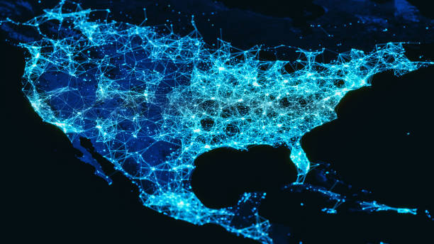
OBJECTIVE
Objective: To accurately forecast the hourly energy consumption for PJM Interconnection LLC over the next 30 days using advanced machine learning and deep learning models.
Context: PJM Interconnection is a major Regional Transmission Organization (RTO) in the United States, responsible for managing electricity supply and demand across 13 states and the District of Columbia. Accurate energy forecasting is critical for grid stability, operational planning, and efficient energy distribution.
“Hello everyone. Today, We are excited to present a data-driven approach to solving a real-world energy forecasting challenge.
In this project, we focused on PJM Interconnection — one of the largest regional transmission organizations in the U.S., serving over 65 million people across 13 states. Our goal was to build a predictive system capable of forecasting hourly electricity demand up to 30 days in advance.”

Slide 3


TABLE OF CONTENTS
EDA
- Data Loading /Understanding
- Data Cleaning
- Data Visualization
Model Building
- Data Preparation/Preprocessing
- Model Implementations
- Evaluation
- Forecasting
Model Deployment
Conclusion

Slide 4



Data Loading/Understanding
Dataset Overview
Source: PJM Interconnection LLC (www.pjm.com)
Data: Hourly electricity demand (in Megawatts) from 2002–2018
Region: Covers 13 U.S. states and the District of Columbia
Use Case: Load forecasting for grid planning and demand-side optimization
Data Ingestion
Loaded using pandas.read_csv() directly from a Google Drive path
Dataset contained timestamped records with the target variable: PJMW_MW
Initial Exploration
Used .info() and .head() to check structure and schema
Verified:
Time-index consistency
Data types
Range of dates available
Ensured no duplicate timestamps
.
"We began by importing PJM's hourly load data, which includes power demand records over multiple years across a large multi-state region. After loading the CSV file using Pandas, we explored the structure, verified timestamp alignment, and confirmed the completeness of the PJMW_MW column, which we’ll be forecasting. This foundational step ensured data quality before applying any modeling or transformation."

Slide 5

Data Cleaning
Cleaning Steps
Forward-filled missing values in PJMW_MW to preserve continuity in time series
Filtered dataset to focus on the most recent 4 years for model training and validation
Ensured datetime index consistency by parsing and setting it properly
Removed temporary helper columns after use
📅 Holiday Feature Engineering
Incorporated U.S. holidays using the holidays Python library
Extended with custom holidays like:
Super Bowl Sunday, Earth Day, Valentine's Day, Halloween, etc.
Generated a unified holiday calendar for 2002–2018
Mapped each timestamp to either:
A known holiday label (e.g., “Christmas Day”)
Or "avg_day" for regular days
Created a new categorical feature: Avg/Holiday_Type
“To ensure the data was model-ready, we handled missing values through forward filling — a safe choice for continuous hourly demand. Since recent data is most relevant for forecasting, we focused on the last 4 years. One of the key value additions in this project was enriching the dataset with holiday information. By using both library-based and custom-calculated holidays, we created a detailed calendar that allowed the models to recognize demand anomalies on special days like Christmas, Super Bowl, or Earth Day”

Slide 6
Statistical Summary
Metric | Value
Count | 143,232
Mean | 5,602 MW
Std. Dev | 979 MW
Min | 487 MW
25th Percentile | 4,906 MW
Median (50%) | 5,530 MW
75th Percentile | 6,252 MW
Max | 9,594 MW
Skewness | 0.33
Kurtosis | -0.22
Missing Values | 0
🔍 Key Insights
Demand is centered around 5,600 MW, with a relatively wide spread (~1,000 MW std dev)
No missing values, indicating excellent data completeness
Distribution shows a slight positive skew (longer tail on the right)
Kurtosis is slightly negative, indicating a flatter-than-normal distribution
Minimum and maximum values indicate significant demand variation — an ideal setup for time series modeling
"To get a foundational understanding of the dataset, we computed descriptive statistics of hourly power consumption. The demand typically centers around 5,600 MW but can swing from as low as 487 MW to nearly 9,600 MW. The slight positive skew and mild kurtosis suggest the data has a balanced distribution with a few high-demand spikes — which is typical in energy grids. Importantly, there were no missing values, giving us a clean starting point for modeling."

Slide 7
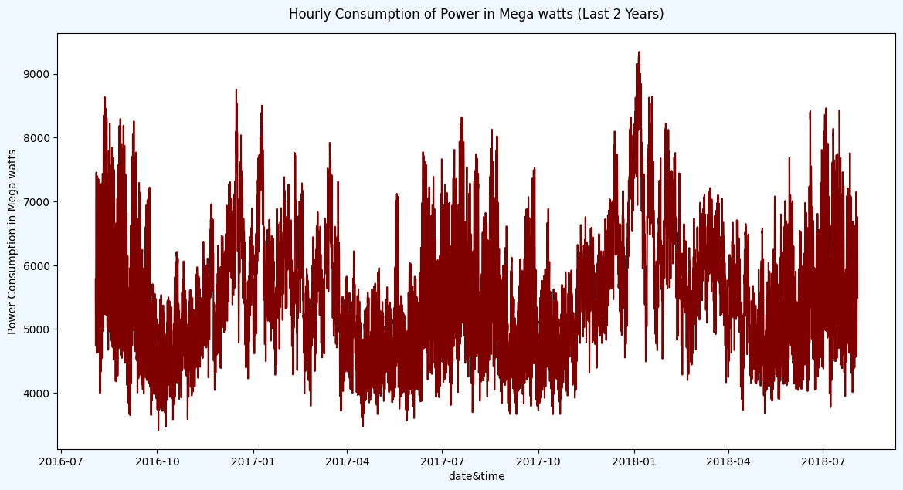
Data
Visualization Highlights
Time span: Mid-2016 to Mid-2018
Granularity: Hourly
Demand values range from ~3,500 MW to 9,500 MW
Clear seasonal patterns visible:
Higher demand in summer and winter (likely due to HVAC loads)
Lower demand in spring and fall
Strong short-term fluctuations layered on top of seasonal trends
Visualization
Interpretation
The series exhibits both long-term seasonal variation and short-term high-frequency spikes
These patterns reinforce the need for models that capture both short- and long-range dependencies
Indicates non-stationarity — a key consideration for time series modeling and decomposition
"This chart shows the hourly power demand for the last two years. As you can see, the consumption exhibits strong seasonal trends — peaking during summer and winter, likely due to air conditioning and heating usage. In addition to seasonality, we also observe sharp short-term fluctuations, which makes this problem suitable for sequence-aware models like TCN and LightGBM. This visualization gave us confidence that a forecasting model must account for both periodic behavior and transient spikes."

Slide 8
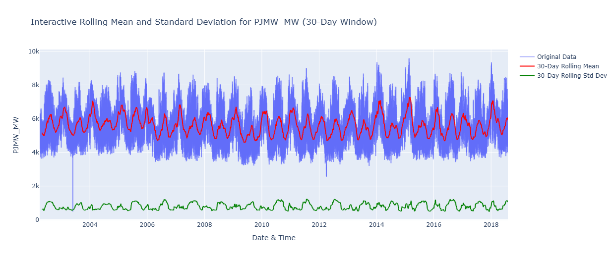
Trend & Volatility Analysis (30-Day Rolling Statistics)
📊 What the Plot Shows
Original data (light blue): Raw hourly power demand
30-day rolling mean (red): Smoothed trend highlighting seasonal cycles and long-term shifts
30-day rolling standard deviation (green): Fluctuation intensity, revealing volatility patterns
🔍 Key Observations
Strong seasonal trend: Regular peaks and troughs every 6–12 months, likely due to summer/winter HVAC loads
Stable variability: The standard deviation remains fairly consistent year to year
Occasional spikes in deviation reflect anomalies or holiday load effects
Rolling mean helps reveal underlying demand growth, independent of hourly fluctuations
"This rolling mean and standard deviation plot gives us a clear view of how power demand changes over time. The red curve smooths out daily noise, making it easier to observe long-term seasonal trends. The green line shows how volatile the demand is — and interestingly, we see fairly consistent fluctuations across the years, with occasional bursts that align with known anomalies or holiday peaks. This analysis confirmed that our dataset exhibits predictable patterns suitable for seasonal modeling."

Slide 9
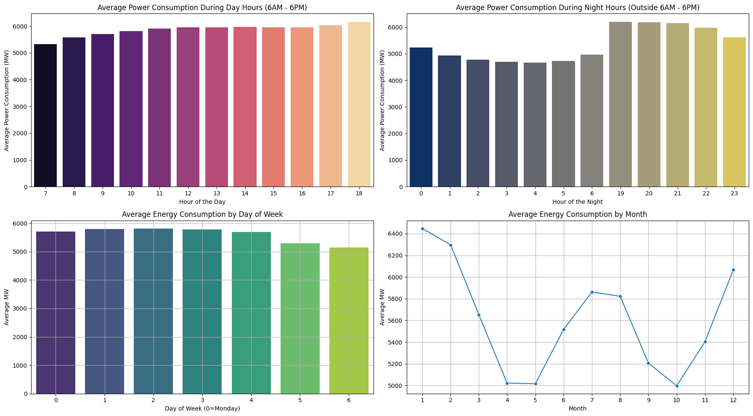
Temporal Patterns in Power Consumption
⏰ Hourly Patterns
Daytime (6 AM – 6 PM): Power demand steadily increases, peaking around 6 PM
Nighttime (6 PM – 6 AM): Demand is lower overnight but rises again from 6 AM
Indicates a strong daily cycle aligned with work schedules and commercial activity
📆 Weekly Patterns
Power consumption is highest Monday–Thursday
Gradual drop on Friday, followed by lowest usage on weekends (Saturday & Sunday)
Suggests reduced industrial/commercial activity during weekends
📅 Monthly Patterns
Peaks in January, July, and December (cold and hot months)
Lowest demand observed in May and October
Reinforces seasonal HVAC effect — heating in winter, cooling in summer
"We analyzed hourly, daily, and monthly variations in energy usage to better understand seasonality. As expected, we see strong diurnal trends — rising demand through the day and tapering off at night. Weekly trends show reduced load on weekends, while monthly patterns confirm peaks during extreme weather seasons. These consistent and predictable patterns validate the use of seasonality-aware models in our forecasting pipeline."

Slide 10
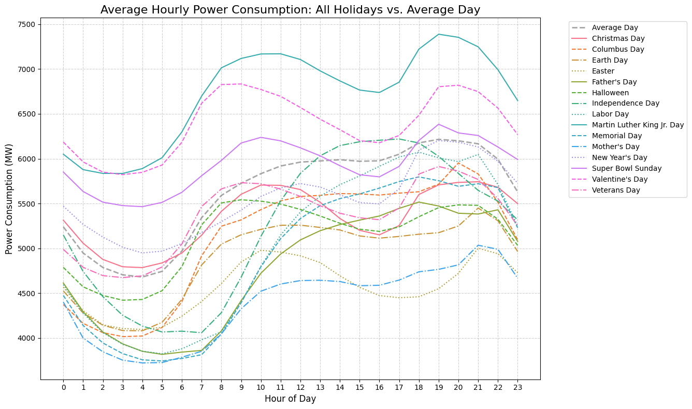
Holiday Impact on Hourly Power Consumption
📊 What the Plot Shows
Comparison of hourly demand on major U.S. holidays vs. an average day
Each line represents a specific holiday’s hourly profile
Grey dashed line represents the overall average weekday as baseline
🔍 Key Insights
Super Bowl Sunday, Martin Luther King Jr. Day, and Valentine's Day show significantly elevated demand in evening hours
New Year’s Day, Christmas, and Easter show consistently lower-than-average demand
Clear evidence of behavioral-driven consumption shifts across holidays
"To quantify the impact of holidays on energy usage, we plotted the average hourly load for each major U.S. holiday and compared it to the overall daily average. Some holidays like Super Bowl Sunday and Martin Luther King Jr. Day show above-average spikes in demand, while others like New Year’s Day show a notable drop. These trends reinforced our decision to engineer a holiday-type feature in the model."

Slide 11
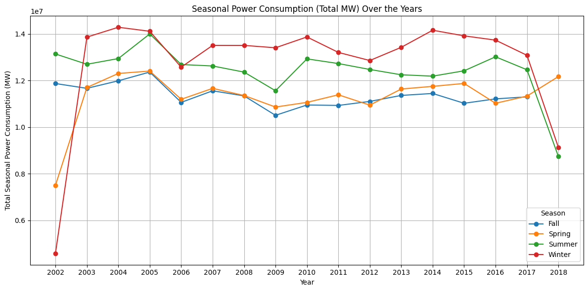
Seasonal Power Consumption Trends (2002–2018)
📊 What the Plot Shows
Total power consumption per season, year by year
Seasons plotted:
🔵 Fall
🟠 Spring
🟢 Summer
🔴 Winter
🔍 Key Insights
Winter consistently has the highest energy consumption, likely driven by heating systems
Summer consumption is slightly lower but still very high due to air conditioning
Fall and Spring show relatively stable and moderate demand
Dips in 2002 and 2018 may be due to data completeness or economic factors
"To understand seasonal shifts in energy usage over time, we analyzed total consumption by season across 17 years. As expected, winter emerges as the most power-intensive season, followed by summer — both corresponding with HVAC-related spikes. Fall and spring are more temperate and stable in demand. These insights helped us validate the seasonal features and reinforced why season-aware models are needed."

Slide 12
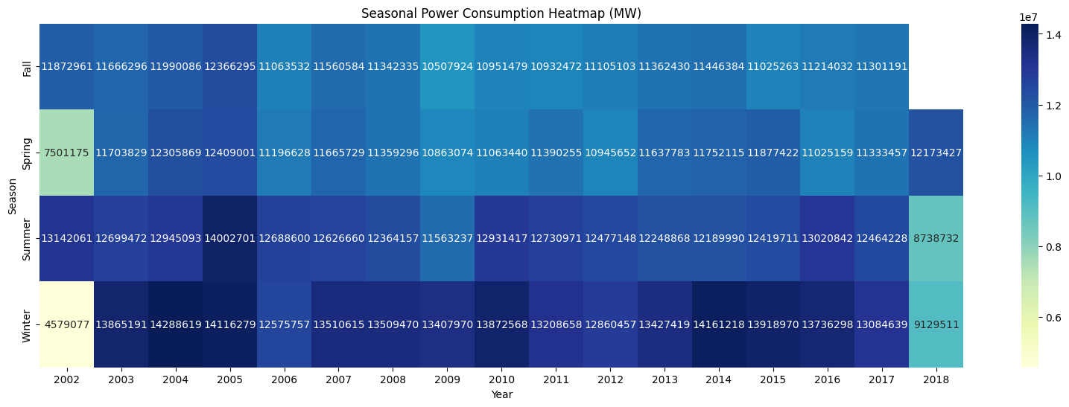
Seasonal Consumption Heatmap (2002–2018)
📊 What the Heatmap Shows
Total power consumption (in MW) grouped by season and year
Each cell reflects aggregated seasonal consumption — darker shades = higher energy use
🔍 Key Insights
Winter consistently shows the highest total energy use, especially post-2003
Summer closely follows, with occasional peak years (e.g., 2005, 2015)
Spring and Fall remain stable with moderate demand
Drop in 2002 and 2018 possibly due to incomplete yearly records
"This seasonal heatmap provides a year-over-year snapshot of total energy demand by season. As the darker blue shades indicate, winters typically consume the most power, followed by summers. This again highlights how temperature extremes drive energy usage. The lighter shades in 2002 and 2018 are likely due to missing or partial data for those years. Overall, this view confirms the significance of seasonal patterns in load forecasting."

Slide 13

Models Building and Evaluation
SARIMAX
Prophet
MAE : 798.61 RMSE : 1020.27 R² : -0.0544.
MAE: 922.31 MW RMSE: 1332008.15 MW R² : -0.3492
NeuralProphet
LSTM/Dart
Xgbm/lgbm
MAE : 232.70 MW RMSE : 295.42 MW R²: 0.9116
MAE : 1002.62 MW RMSE : 1048880.37 MW R² : -0.0624
MAE : 67.19 MW RMSE : 7828.96 MW R² : 0.9921 MAE : 65.21 MW RMSE : 7250.91 MW R² : 0.9927.
MAE : 585.46 MW RMSE : 538251.50 MW R² : 0.4548.

Slide 14
Best Model :TCN
MAE : 84.42 MW RMSE : 11665.53 MW R² : 0.9882
LightGBM and XGBoost delivered exceptional accuracy with minimal training time but these aren’t not a time series models
TCN outperformed LSTM in deep learning setup due to dilated convolutional structure
Prophet and SARIMA models struggled due to high variance and long forecast window
Including holiday and seasonal features enhanced all models, especially tree-based ones
Tree-based models offer great balance of accuracy, interpretability, and scalability
"We tested a diverse range of models — from traditional statistical models like SARIMA, to deep learning architectures like LSTM and TCN, and robust ensemble models like LightGBM and XGBoost. The results showed that LightGBM and XGBoost consistently outperformed others in both accuracy and speed. Among deep learning models, TCN stood out with its ability to handle long input-output sequences effectively. These models, combined with strong feature engineering, allowed us to deliver a highly accurate 30-day hourly forecast."

Slide 15
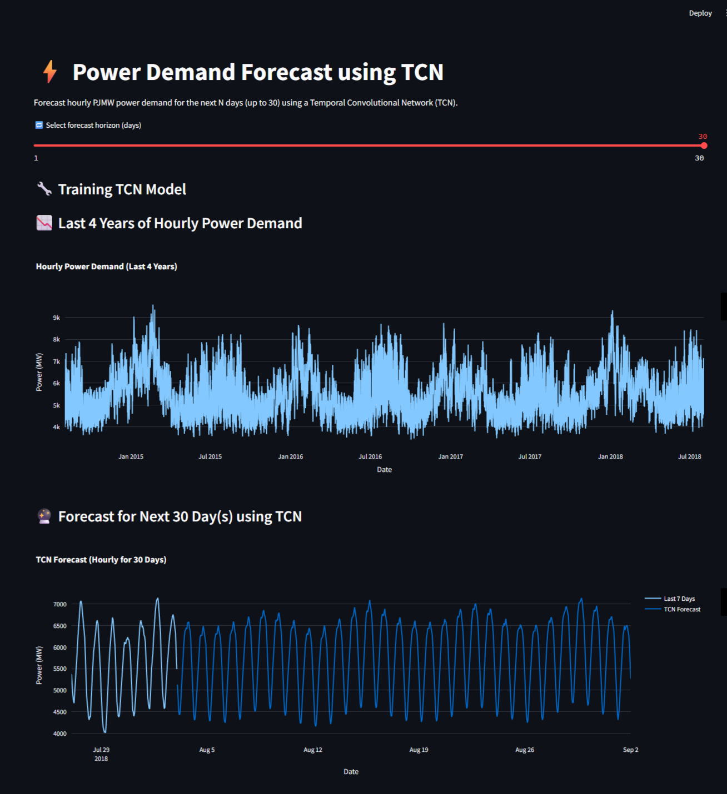
Model Deployment
⚙️ Technology Stack
Frontend: Streamlit (Python-based interactive web app)
Backend: Temporal Convolutional Network (TCN) trained on 4 years of PJM data
Libraries Used: Keras, TCN, Scikit-learn, Plotly
💡 Features of the Application
📅 Interactive Forecast Slider: Allows users to select a custom forecast horizon (1 to 30 days)
🔄 Live TCN Model Training: Trains the TCN model on the fly using the most recent 4 years of hourly power consumption
📉 Historical Visualization: Displays a detailed interactive plot of the last 4 years of hourly demand data
🔮 Forecast Output Plot: Shows the predicted power usage for the selected number of days, alongside the last 7 days of actual data
📥 Download Forecast CSV: Users can export the forecast results for further offline analysis

Slide 16
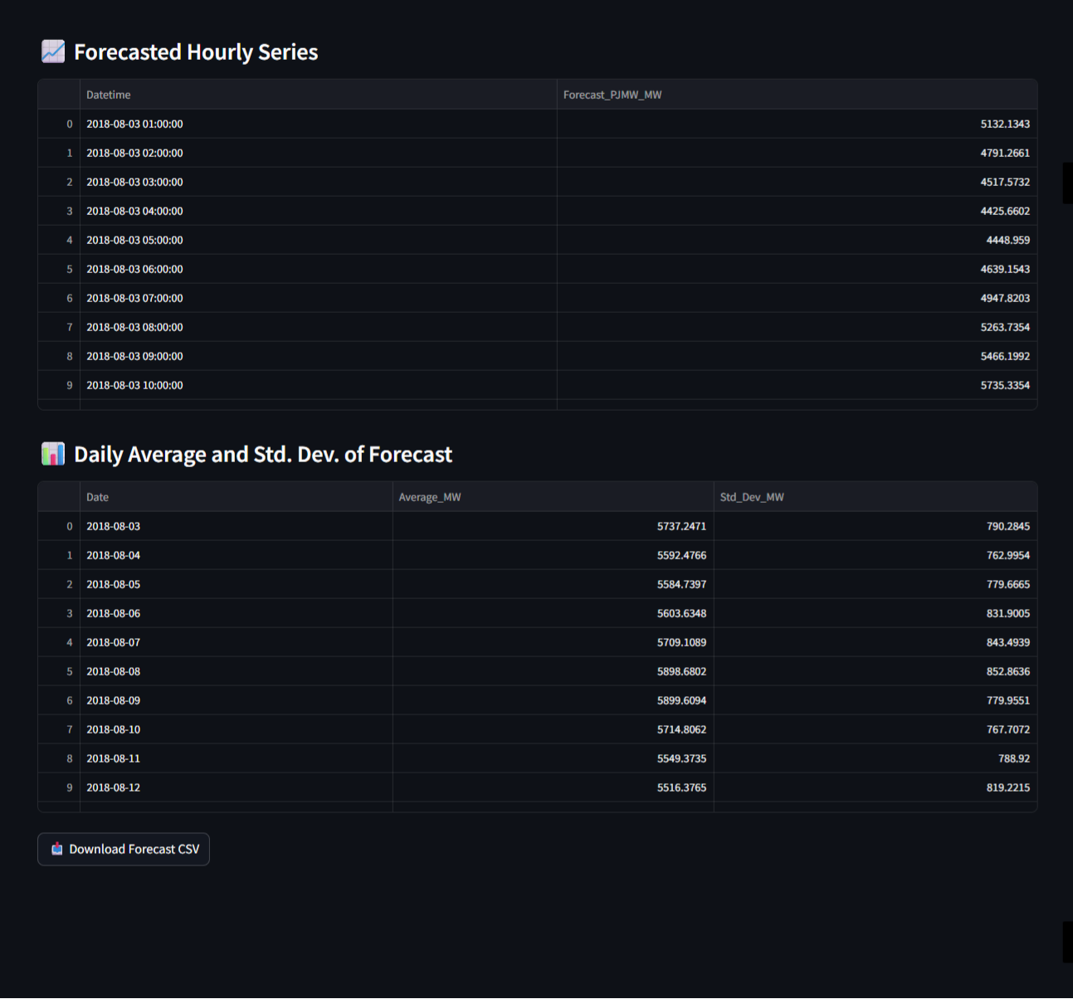
Forecast Output and Interpretability
📈 Forecasted Hourly Series
Displays hourly predictions for the selected forecast horizon (up to 720 hours)
Includes timestamps and corresponding predicted demand in MW
Enables analysts to inspect short-term operational readiness, hour by hour
📊 Daily Aggregation Metrics
Computes and displays:
📌 Average daily power consumption
📈 Standard deviation to reflect forecast volatility
Offers quick insights into:
Daily load expectations
Peak planning and load variability
💾 Downloadable Output
One-click export of entire forecast dataset (forecast.csv)
Enables offline analysis or integration into planning workflows
"The app doesn't stop at just forecasting — it enhances usability by presenting results in a structured and interpretable format. Users can explore the full hourly forecast or review daily-level summaries with average demand and volatility. This is crucial for both operational and strategic decision-making in energy systems. The downloadable CSV ensures the forecast can be integrated into existing tools or reports with ease."

Slide 17
Challenges Faced
Handling Large-Scale Time Series Data
Working with 140,000+ hourly records required efficient memory management and careful resampling to avoid performance bottlenecks.
Capturing Long-Term Seasonality
Modeling both short-term (hourly/daily) and long-term (monthly/seasonal) trends was difficult, especially for deep learning models like LSTM and TCN.
Model Selection & Tuning
Balancing interpretability, performance, and forecast horizon led to extensive experimentation across statistical, machine learning, and deep learning models.
Multi-Step Forecasting Complexity
Predicting 720 hours ahead (30 days) with high accuracy introduced challenges like error accumulation and the need for sequence-to-sequence design.
Real-Time Deployment Constraints
Packaging models like TCN into an interactive and responsive web app required careful optimization to ensure fast predictions and a smooth user experience.

Slide 18


Group 4
Shruti Pawar
VICTOR SOLOMON D
Shashidhar G Hullavarad
Anupam V
Kampelly Shyam Kumar
Barigela Uday Kumar
Pravalika Challuri
THANK YOU

